Slide 1
﻿Graph Neural Networks for Molecular Property Prediction in Drug Discovery
﻿Rahman Abdul Rafi, Samarth Begari, Toral Chauhan
9th December 2025

Slide 2
Introduction
10+ Years | $2.6 Billion | 90% Failure Rate
To discover a drug Cost per successful drug Failure in clinical trials
Traditional QSAR models rely on handcrafted fingerprints that don’t generalize well.
GNNs learn directly from molecular graphs, capturing local and global structure.
This leads to more accurate and scalable molecular property prediction.
Notes:
Getting one successful drug to market typically takes over 10 years, costs around $2.6 billion, and still 90% of candidates fail in clinical trials.
“That’s why we need good computational models to screen and prioritize molecules early.”
“Traditional QSAR models take a molecule, convert it into a fixed fingerprint vector, and train RF or MLP on top. These fingerprints are hand-designed and can struggle with new chemical scaffolds.”
“Our idea is to use graph neural networks, which learn directly from the molecular graph, to better capture both local chemistry and overall shape.

Slide 3
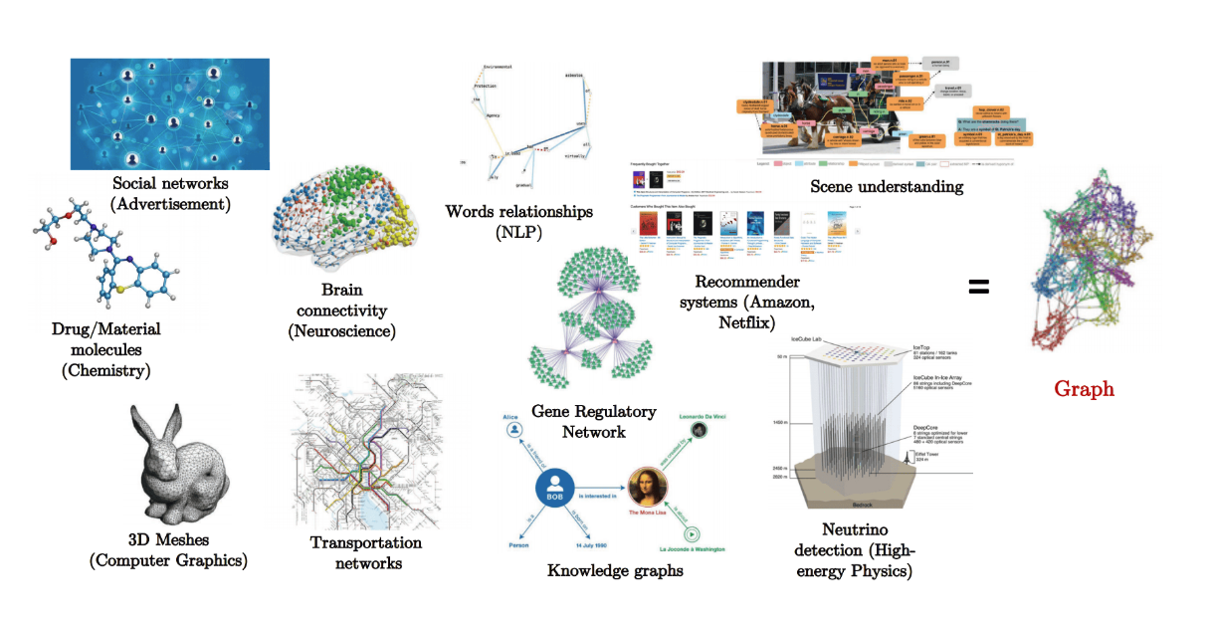
Graph Structured Data
Image source : https://hal.cse.msu.edu/teaching/2024-spring-deep-learning/16-graph-neural-networks/#/1
Notes:
“Many problems can be represented as graphs: social networks, knowledge graphs, molecules.”
“A graph has nodes (objects) and edges (relationships).”
“Our molecules will be graphs where atoms are nodes and bonds are edges.”

Slide 4
GNN
Graph Neural Networks are models designed to work with graph data (nodes + edges).
Each node updates itself by collecting information from its neighboring nodes.
This process of sharing information is known as message passing.
After several rounds, nodes gain a richer understanding of their local structure.
A final step combines all node information into a graph-level output.
Image Source: https://machinelearningknowledge.ai/graph-neural-networks-gnn-explained-for-beginners/
Notes:
“A GNN is a neural network designed for graphs.”
“Each atom starts with some features (element, charge, etc.). At each GNN layer, every atom looks at its neighbors and updates its own vector. This is called message passing.”
“After a few layers, each atom’s vector encodes information about a larger part of the molecule.”
“Then we pool all atom vectors into a single vector for the whole molecule, and use that to predict toxicity, solubility, etc.”

Slide 5
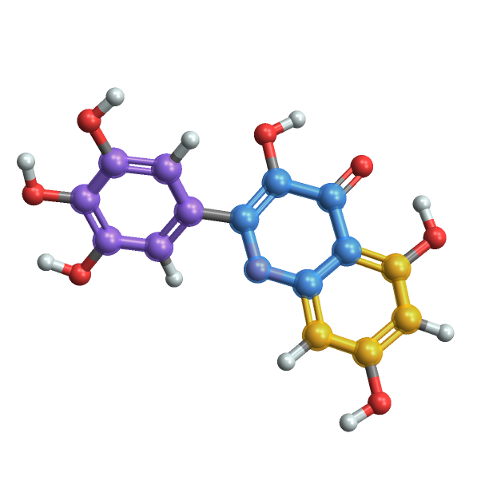
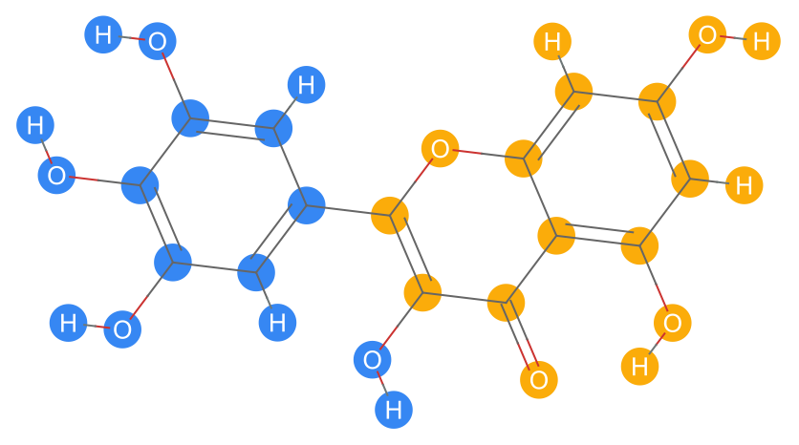
Molecules as Graphs
A natural way to represent molecules is as graphs
Atoms → nodes
Bonds → edges
Node and edge features include: atom type, mass, charge, hybridization, bond type, aromaticity
Notes:
This is where graphs become chemistry: each atom is a node, each bond is an edge.”
“For each atom we encode features like: element (C/N/O), formal charge, is it aromatic, degree, hybridization, chirality.”
“For each bond we encode: bond type (single, double, triple, aromatic), whether it’s in a ring, conjugated, etc.”
“Those features form data.x and data.edge_attr in PyTorch Geometric. They are the inputs to our GNN.”

Slide 6
Data used
Dataset | Task Type | Total Molecules | Train / Val / Test Split | Label Type
Tox21 | Multi-label Classification | ~7,800 | 6,200 / 800 / 800 | 12 Binary Labels
BBBP | Binary Classification | ~2,050 | 1,640 / 205 / 205 | 1 Binary Label
ESOL | Regression (Solubility) | 1,128 | 904 / 112 / 112 | Continuous (logS)
Notes:
“We work with three MoleculeNet datasets:
ESOL – 1.1k molecules, predicting logS (aqueous solubility). Regression.
Tox21 – ~7.8k molecules, 12 toxicity assays. Multi-label classification.
BBBP – ~2k molecules, blood–brain barrier permeability. Binary classification.”
“All datasets are standard benchmarks for molecular property prediction.”

Slide 7
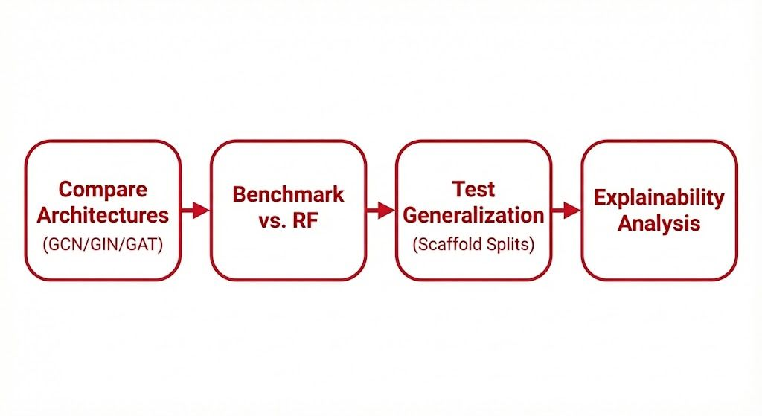
Objective
Notes:
We are comparing 3 NN architectures GCN, GIN and GAT
Then we bencharmarked it against the traditional RF to see how our model behaves
Then comes the test generalization where we used scaffold splits which ensures that the testing molecules and the training are different so that our model can learn from the new ones.
And finally we have explainability anal

Slide 8
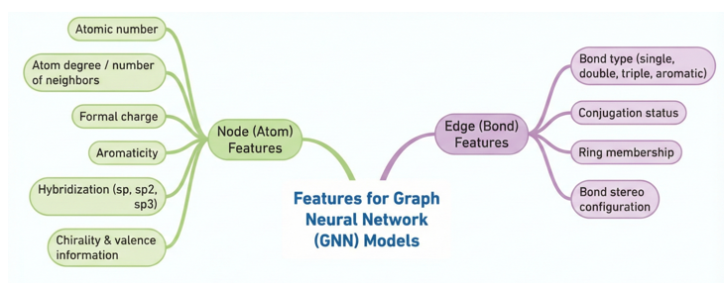


Features
These features are extracted using RDKit and form the input to GNN models.
Notes:
“We use RDKit to compute all atom and bond features.”
“For atoms: atomic number, degree, formal charge, aromaticity, hybridization, chirality, valence, etc.”
“For bonds: bond type, conjugation status, ring membership, stereo configuration.”
“We one-hot encode or otherwise numericize these features so the GNN can learn from them.”

Slide 9
Related Work
Prior Work
Our Contribution
Traditional QSAR: Relies on handcrafted fingerprints that fail to generalize to new chemical scaffolds.
MoleculeNet Benchmark: Established standard datasets (Tox21, ESOL) and metrics for fair evaluation.
GNN Promise: Recent studies show GNNs (GCN, GAT) improve ADMET prediction by learning directly from graph structures.
Comparative Analysis: We benchmark GCN, GIN, and GAT directly against Random Forest baselines on identical datasets.
True Generalization: We enforce Scaffold Splitting (not random split) to test if models can handle unseen chemical structures.
Interpretability: We use Attention Mechanisms (GAT) to identify the specific atoms driving toxicity, not just predict it.
Multi-Task Validation: We validate performance across diverse tasks: Classification (Tox21/BBBP) and Regression (ESOL)
Notes:
Background Summary
Traditional QSAR models rely on fixed fingerprints and RF/MLP, but they often break on unseen molecular scaffolds.
MoleculeNet standardized datasets like Tox21 and ESOL and set the benchmark metrics we follow.
Recent work shows GNNs especially GAT and MPNNs improve ADMET prediction by learning directly from molecular graphs.
Our Contributions
Directly compare three GNNs against RF/MLP under identical conditions.
Use scaffold splits to measure real generalization, not memorization.
Add interpretability through GAT attention maps.
Evaluate across multiple task types: toxicity (Tox21/BBBP) and solubility (ESOL).

Slide 10
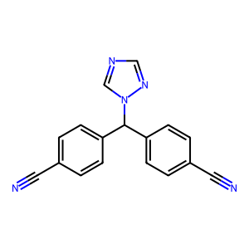
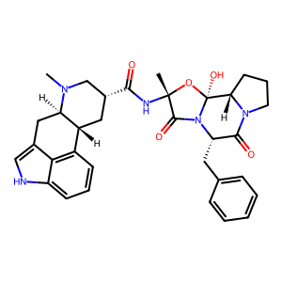
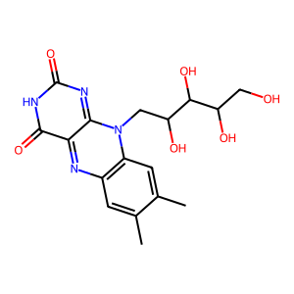
Method - Expected Output
Tox21 – Toxicity Profiling (Multi-Task Classification) • Predict 12 toxicity outcomes per molecule (multi-label). • Output: 12 binary probabilities. • Metric: ROC-AUC (macro) separates toxic vs non-toxic across assays.
BBBP – Blood–Brain Barrier Permeability (Binary Classification) • Predict whether a molecule can cross the BBB. • Output: 1 probability (permeable / not). • Metric: ROC-AUC rank permeable above non-permeable.
ESOL – Aqueous Solubility (Regression) • Predict continuous solubility (logS). • Output: one real-valued prediction. • Metrics: RMSE (strict on big errors), MAE (clean interpretability).
Notes:
“For Tox21, the model has to learn signals from 12 different toxicity tests, so it’s a good measure of how well it handles biological complexity. We use macro ROC-AUC to see how well it separates toxic from non-toxic across all tasks.
For BBBP, the goal is to predict whether a molecule crosses the blood–brain barrier. Even tiny structural changes can flip the outcome, so ROC-AUC tells us if the model is really capturing the patterns behind permeability.
For ESOL, we’re predicting solubility a pure physical chemistry property with no biology involved. RMSE and MAE show how close the predictions are to real values.
Using all three datasets gives us a complete picture: Tox21 tests biological understanding, BBBP tests permeability behavior, and ESOL tests fundamental chemical structure-property relationships.
Together, they reveal whether the model truly learns chemistry, instead of just memorizing data.

Slide 11
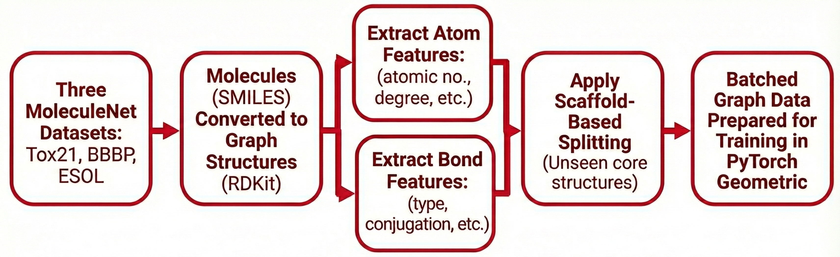
Method- Data processing pipeline
Notes:
We start by loading the MoleculeNet datasets in SMILES form. Using RDKit, each SMILES string is converted into a molecular graph, and we extract all relevant atom and bond features. These graphs are then packaged into PyTorch Geometric format so they can be fed into GNN models. After that, we apply a scaffold split to make sure our train, validation, and test sets contain different core structures, which avoids data leakage. Finally, the graphs are batched into loaders, and the models are trained on clean, consistent graph data.

Slide 12
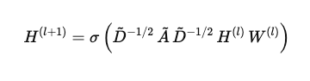
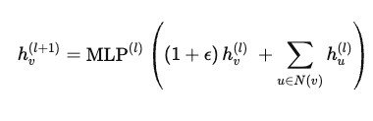
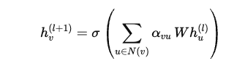
Method- GNN Architecture
Architecture | Description (What It Does) | Update Formula
GCN (Graph Convolutional Network) | • Applies convolution over graphs using normalized neighbor aggregation. • Adds self-loops for stability. • Efficient at capturing local structural patterns.
GIN (Graph Isomorphism Network) | • Matches the discriminative power of the Weisfeiler–Lehman test. • Uses MLP-based aggregation for strong structural sensitivity. • Excellent for fine-grained molecular differences.
GAT (Graph Attention Network) | • Uses attention to weight neighbors differently based on importance. • Learns which atomic interactions matter most. • Captures long-range and chemically relevant dependencies.
Notes:
“These formulas show how each model updates an atom’s features. GCN averages information from its neighbors. GIN adds the atom’s own features to its neighbors and passes it through an MLP for stronger discrimination. GAT uses attention weights so the atom focuses more on important neighbors. Each formula represents a different way of learning structure in the molecule.”

Slide 13
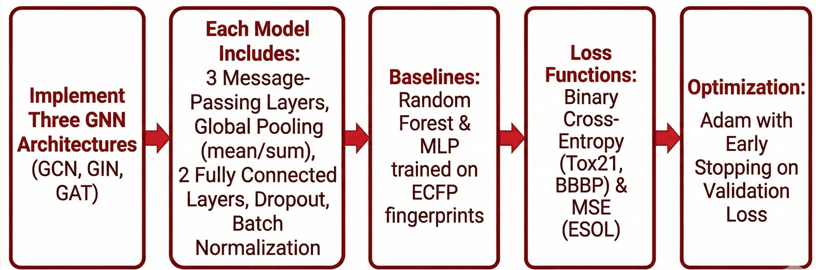


Method- Algorithm
Notes:
We start by implementing three different GNN architectures GCN, GIN, and GAT
so we can compare how each message-passing strategy performs. All models share the same overall design: three message-passing layers, a global pooling step, and two fully connected layers with dropout and batch normalization for stability. To ground our results, we also include strong traditional baselines: Random Forest and an MLP trained on ECFP fingerprints.
For the loss functions, we use binary cross-entropy for the classification datasets, Tox21 and BBBP, and MSE for the regression dataset, ESOL.
Finally, everything is trained using the Adam optimizer with early stopping on validation loss to prevent overfitting and ensure fair comparison across models.

Slide 14
Experimental Setup- Models and Training
GNNs Used: GCN, GIN, GAT
Layers: 3 message-passing layers
Hidden Dimensions:
128 (GCN, GIN),
64 (GAT)
Pooling:
Mean (GCN, GAT),
Sum (GIN)
Activation:
ReLU (GCN, GIN),
ELU (GAT)
Regularization:
Dropout 0.2 (GCN),
0.3 (GIN/GAT) + BatchNorm in intermediate layers
Hyperparameters
Learning Rate: • GCN: 1e-3
• GIN: 1e-3
• GAT: 5e-4
Batch Size: • GCN / GIN: 64
• GAT: 32
Optimizer: Adam
Seeds: Fixed for reproducibility
Notes:
We kept the setup consistent across all models — same number of layers, similar hidden sizes, same optimizer, and fixed seeds. Only architecture-specific settings changed, like attention heads for GAT or pooling for GIN.
This gives a genuinely fair, comparison. No model gets extra capacity or an easier training recipe. Any performance gain comes from the architecture itself not from extra tuning.

Slide 15
Training Setup
Loss Functions: • Binary Cross-Entropy → Tox21, BBBP • MSE → ESOL
Dataset Split: Scaffold-based (train/val/test)
Epochs: • Typical range: 50–150 • Early stopping on validation loss • GAT trains slower (~120–150 epochs) • GCN/GIN converge faster (~80–120 epochs)
Notes:
We train with:
Binary cross-entropy for Tox21/BBBP.
MSE for ESOL.
We always use scaffold-based splits to avoid data leakage across scaffolds.”
“We run 50–150 epochs with early stopping based on validation performance, and fix seeds for reproducibility.”
“GAT models usually need slightly more epochs to converge compared to GCN/GIN.”

Slide 16
Hardware
NVIDIA RTX 3090 for baseline and debugging runs
NVIDIA RTX 5080 for full multi-epoch training and hyperparameter sweeps
Apple MacBook M3 & M4 chips — used for development, testing, and lightweight model runs.
GPU acceleration was essential: It reduced training time dramatically compared to CPU-only execution, especially for deeper models and attention-based architectures like GAT

Slide 17
Results
Performance Comparison across Baseline models- ESOL dataset
Model | RMSE (mean ± std) | MAE (mean ± std)
GAT | 1.3498 ± 0.0916 | 1.0400 ± 0.1041
GIN | 1.3549 ± 0.1161 | 0.9902 ± 0.1034
GCN | 1.4679 ± 0.0603 | 1.0905 ± 0.0397
MLP | 1.5064 ± 0.0375 | 1.1892 ± 0.0174
RF | 1.6238 ± 0.0029 | 1.2576 ± 0.0034
Notes:
Random Forest had the highest error (1.62), while our GAT model achieved the lowest error (1.35). This proves that when the chemistry gets complex, the GNN's ability to learn from the graph structure is superior to traditional fingerprints

Slide 18
Results
Performance Comparison across Baseline models- Tox21 dataset
Model | AUC (mean ± std) | BCE (mean ± std)
Random Forest | 0.7493 ± 0.0044 | 0.2759 ± 0.0022
GAT | 0.6716 ± 0.0022 | 0.3297 ± 0.0036
MLP | 0.6599 ± 0.0022 | 1.0455 ± 0.0147
GIN | 0.754 ± 0.0089 | 0.3559 ± 0.0136
GCN | 0.6179 ± 0.0046 | 0.3359 ± 0.0004
Notes:
This suggests that GIN is better at the core task of classifying correctly, but Random Forest is more conservative with its probability estimates, resulting in a lower loss score. For drug discovery screening, we generally prioritize AUC because our main goal is to rank the best candidates first

Slide 19
Results
Performance Comparison across Baseline models- BBBP dataset
Model | AUC (mean ± std) | BCE (mean ± std)
Random Forest | 0.9411 ± 0.0030 | 0.2517 ± 0.0469
MLP | 0.9300 ± 0.0264 | 0.5187 ± 0.1234
GAT | 0.8203 ± 0.0415 | 0.4734 ± 0.0437
GIN | 0.8040 ± 0.0400 | 0.4363 ± 0.0229
GCN | 0.7630 ± 0.0400 | 0.4787 ± 0.0590
Notes:
AUC value not there in sheet how can do this

Slide 20
Results
Performance Comparison across GNN models
Dataset | Best Model | Metric | Score | Notes
Tox21 | GAT | ROC-AUC ↑ | ~0.753 | Attention highlights toxic substructures
BBBP | GAT | ROC-AUC ↑ | ~0.82 | GCN overfits (AUC=1.00)
ESOL | GAT | RMSE ↓ | ~1.14 | Best solubility predictions
Notes:
Idk what is arrow. For now we put lowest RMSE GAT value from esol_gat_hyp_result sheet. We put best Tox21(from what Rahman ran the highest value was 0.753 for GIN. For GAT Tox21 we took highest value from ur excel sheet – tox_gat_hyp_result and BBMP value(auc mean) from summary all baselines xlcx
On ESOL, both GIN and GAT significantly outperform GCN. GAT gives us the lowest RMSE, so it’s our best overall regressor, while GIN edges it out slightly on MAE. This supports the choice of GAT as the hero model for solubility, with GIN as a strong runner-up.”
On Tox21 : GAT clearly wins on AUC (0.67 vs 0.63 and 0.62). It ranks actives vs inactives notably better than GIN/GCN.
GAT also has the lowest BCE, which means its probabilities are better calibrated.
GIN is second; GCN is consistently worst.
On BBBP:GAT has the highest AUC (0.82), so it’s best at ranking BBB-permeable vs non-permeable compounds.

Slide 21
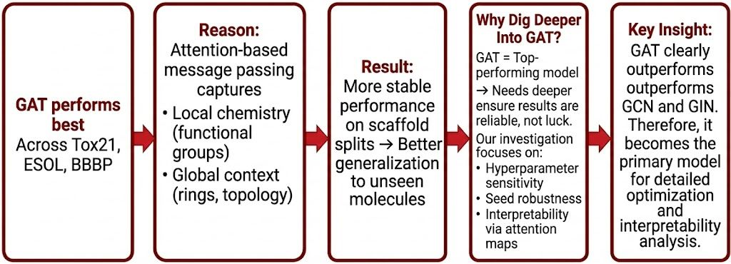
GAT with different hyperparameters

Slide 22
GAT with different hyperparameters
Section | Description
Hyperparameter Sweep (AUC-Based Model Selection) | • Structured search over: – hidden_dim: 64, 128, 256 – dropout: 0.1, 0.3, 0.5 – attention heads: 4, 8 – seeds: 0, 1, 2 • Ensures: – Robust best-config selection – Fair comparison across datasets – Statistical stability using mean ± std AUC
Attention Visualizations (Interpretability) | • Retrained the best-performing GAT configuration. • Extracted per-edge attention weights from final GAT layer. • Converted attention → per-atom importance scores. • Generated RDKit images coloring high-attention atoms in red. • Shows GAT highlights chemically meaningful substructures (toxicophores, functional groups, polar regions).
Notes:
First, we ran a structured hyperparameter sweep—changing hidden size, dropout, attention heads, and multiple seeds. This ensures the GAT model we choose isn’t a lucky one-off but a consistently strong performer across configurations, measured by mean and standard deviation of AUC.
Second, after selecting the best configuration, we retrained GAT and extracted its attention weights. We converted those into per-atom importance scores and visualized them using RDKit. These images show that GAT focuses on chemically meaningful regions—like toxicophores and functional groups—which tells us the model isn’t just accurate, it’s also interpretable.
So overall, this slide shows that GAT’s performance is both robust and chemically grounded.

Slide 23
GAT Attention Images
What the Images Show
GAT produces attention weights that indicate how important each atom is for the prediction.
Atoms are colored by importance: Red = high attention, White = low attention.
Why These Images Matter
Show interpretability by highlighting key functional groups.
Build trust by confirming the model focuses on meaningful chemical regions.
Help debug when attention appears on irrelevant atoms.
Validate that the chosen hyperparameters improve chemical insight, not just metrics.
What They Suggest
GAT learns real structure–property patterns, not random correlations.
Predictions are explainable, not just high-scoring.

Slide 24
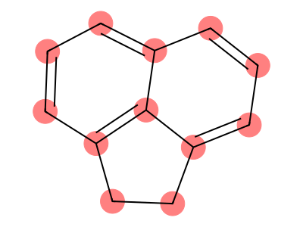
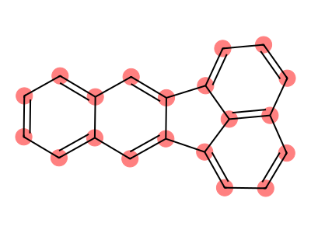
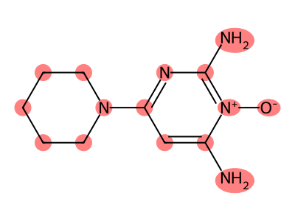
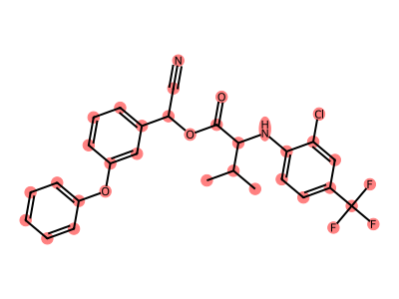
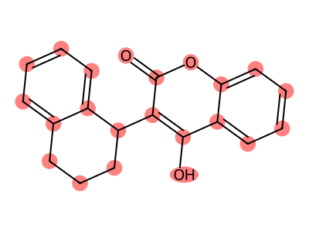
ESOL
Notes:
GAT’s last layer returns attention weights on edges.
You aggregate them into per-atom scores (edge_attention_to_atom_weights).
Then draw_molecule_with_atom_attention colors each atom:
More red = higher attention weight
More white/pale = lower attention

Slide 25
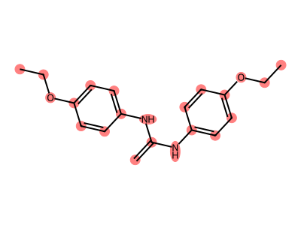
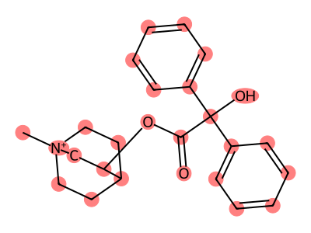
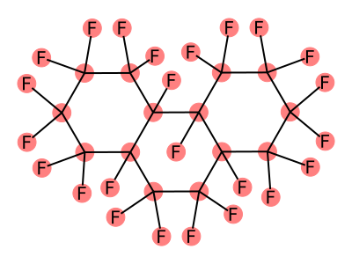
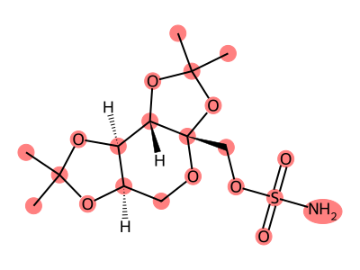
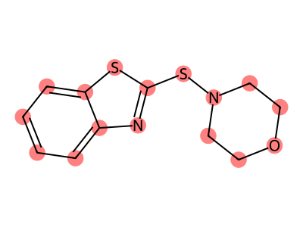
TOX21

Slide 26
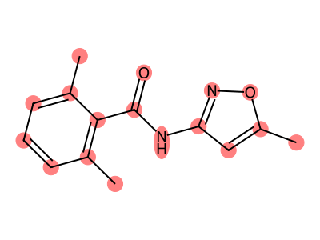
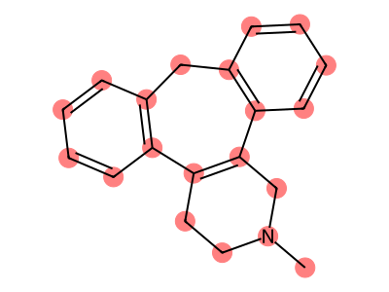
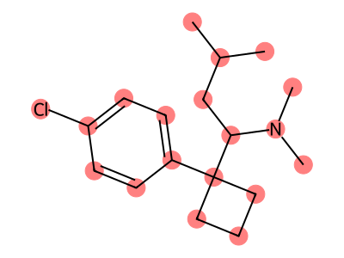
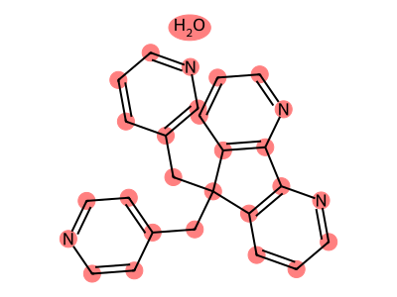
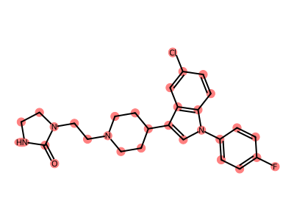
BBBP

Slide 27
Key Findings
Model Performance Across Datasets
We evaluated GCN, GIN, GAT, Random Forest, and MLP on Tox21, BBBP, and ESOL.
Overall, GAT performs the best, especially in ESOL (regression).
Random Forest remains a strong baseline on small datasets like BBBP.
GCN tends to underperform or overfit, depending on dataset size.
GIN performs well on tasks requiring fine structural discrimination (e.g., Tox21).
Notes:
Across all datasets, GAT is typically the best GNN, but not always the best overall model.”
“On ESOL, GIN/GAT do outperform RF/MLP, which is a clear win for GNNs on regression.”
“On Tox21 and BBBP, RF/ECFP remains the top performer in AUC; GAT is the strongest GNN but trails RF.”
“GCN is generally weaker than GIN/GAT, confirming that more expressive GIN and attention-based GAT are better suited for these tasks.”
“So the story is: GNNs are especially useful for some properties (like solubility) and for interpretability, but RF is still a tough baseline on toxicity/permeability.”

Slide 28
Conclusion and Future Work
Are the results meet your expectations?
Yes, the project did meet our expectations
Our GAT model cut the error by 17% compared to Random Forest
GNNs proved they understand continuous properties better than the baselines.
Graph-based learning outperforms static fingerprints for physical property prediction.
Future Work
Extending benchmarks to HIV and Lipophilicity datasets.
Reducing the $2.6 billion discovery cost via scalable, data-driven screening.
Tackling data scarcity issues observed in the BBBP dataset.
Notes:
In conclusion, our experiments prove that treating molecules as graphs is superior for predicting complex physical properties. While the Random Forest baseline held its ground on simple classification tasks, our GAT model achieved a 17% error reduction on the Solubility dataset. This confirms that the Attention mechanism effectively captures the subtle physics of how a drug dissolves, which fingerprints simply cannot see.
However, we also identified that GNNs are data-hungry. To solve the overfitting we saw on BBBP, our next phase involves scaling up. We plan to utilize our NVIDIA RTX 5080 to pre-train these models on millions of molecules before fine-tuning them on specific tasks like HIV or Lipophilicity

Slide 29
References
[1] Fang, Z., Zhang, X., Zhao, A., Li, X., Chen, H., & Li, J. (2025). Recent developments in GNNs for drug discovery. arXiv preprint arXiv:2506.01302. https://arxiv.org/abs/2506.01302
[2] Yao, R., Shen, Z., Xu, X., Ling, G., Xiang, R., Song, T., Zhai, F., & Zhai, Y. (2024). Knowledge mapping of graph neural networks for drug discovery: A bibliometric and visualized analysis. Frontiers in Pharmacology, 15, 1393415. https://doi.org/10.3389/fphar.2024.1393415
[3] Besharatifard, M., & Vafaee, F. (2024). A review on graph neural networks for predicting synergistic drug combinations. Artificial Intelligence Review, 57, 49. https://doi.org/10.1007/s10462-023-10669-z
[4] Wu, Z., Ramsundar, B., Feinberg, E. N., Gomes, J., Geniesse, C., Pappu, A. S., Leswing, K., & Pande, V. (2018). MoleculeNet: A benchmark for molecular machine learning. Chemical Science, 9(2), 513–530. https://doi.org/10.1039/C7SC02664A
[5] Altae-Tran, H., Ramsundar, B., Pappu, A. S., & Pande, V. (2017). Low data drug discovery with one-shot learning. ACS Central Science, 3(4), 283–293. https://doi.org/10.1021/acscentsci.6b00367
[6] Stokes, J. M., Yang, K., Swanson, K., Jin, W., Cubillos-Ruiz, A., Donghia, N. M., MacNair, C. R., French, S., Carfrae, L. A., Bloom-Ackermann, Z., et al. (2020). A deep learning approach to antibiotic discovery. Cell, 180(4), 688–702.e13. https://doi.org/10.1016/j.cell.2020.01.021
[7] Zhou, J., Cui, G., Hu, S., Zhang, Z., Yang, C., Liu, Z., Wang, L., Li, C., Sun, M., & Song, C. (2020). Graph neural networks: A review of methods and applications. AI Open, 1, 57–81. https://doi.org/10.1016/j.aiopen.2021.01.001
[8] Kipf, T. N., & Welling, M. (2017). Semi-supervised classification with graph convolutional networks. International Conference on Learning Representations (ICLR). https://arxiv.org/abs/1609.02907
[9] Xu, K., Hu, W., Leskovec, J., & Jegelka, S. (2019). How powerful are graph neural networks? International Conference on Learning Representations (ICLR). https://arxiv.org/abs/1810.00826
[10] Veličković, P., Cucurull, G., Casanova, A., Romero, A., Liò, P., & Bengio, Y. (2018). Graph attention networks. International Conference on Learning Representations (ICLR). https://arxiv.org/abs/1710.10903

Slide 30
Project Link
https://github.com/toraljoshi27/GNN_drug_discovery

Slide 31
THANK YOU

